Slide 1
Database Administrator
Master Time Table

Slide 2
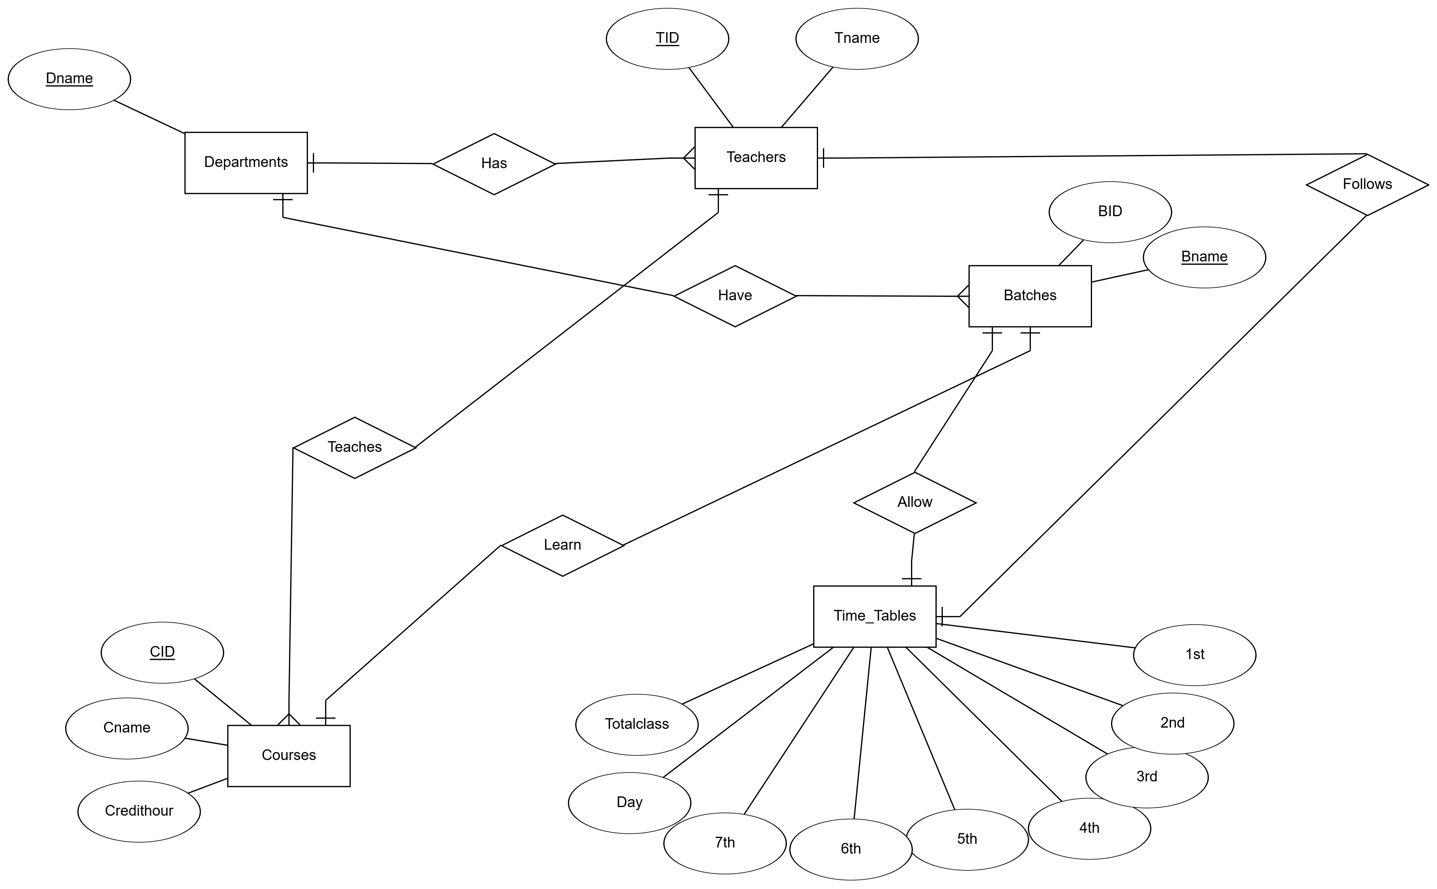
ER DIAGRAM

Slide 3
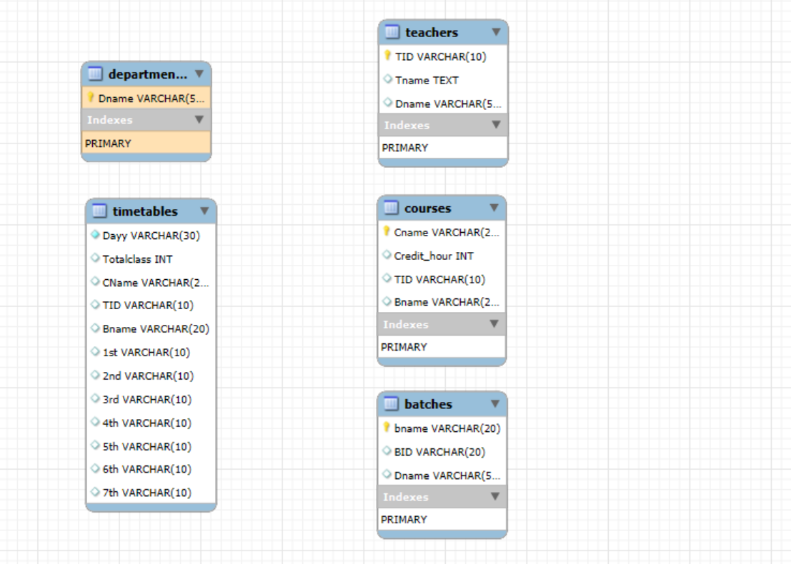
LOGICAL Schema

